Slide 1
JAVA
INTRODUCTION

Slide 2
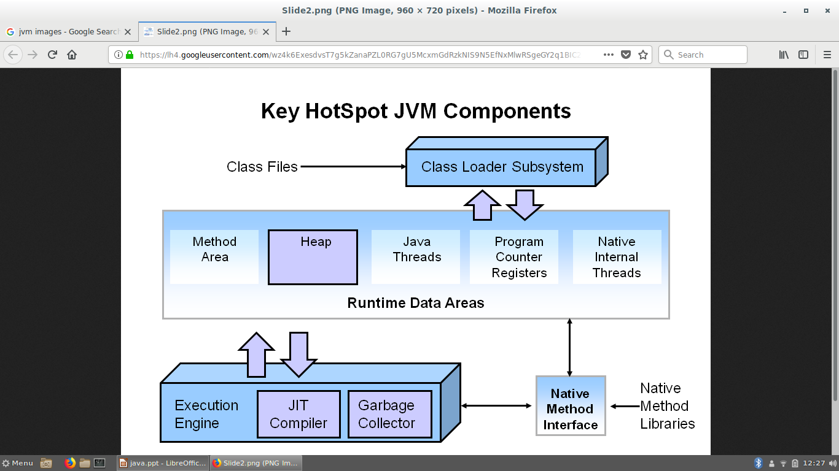
JVM Overview

Slide 3
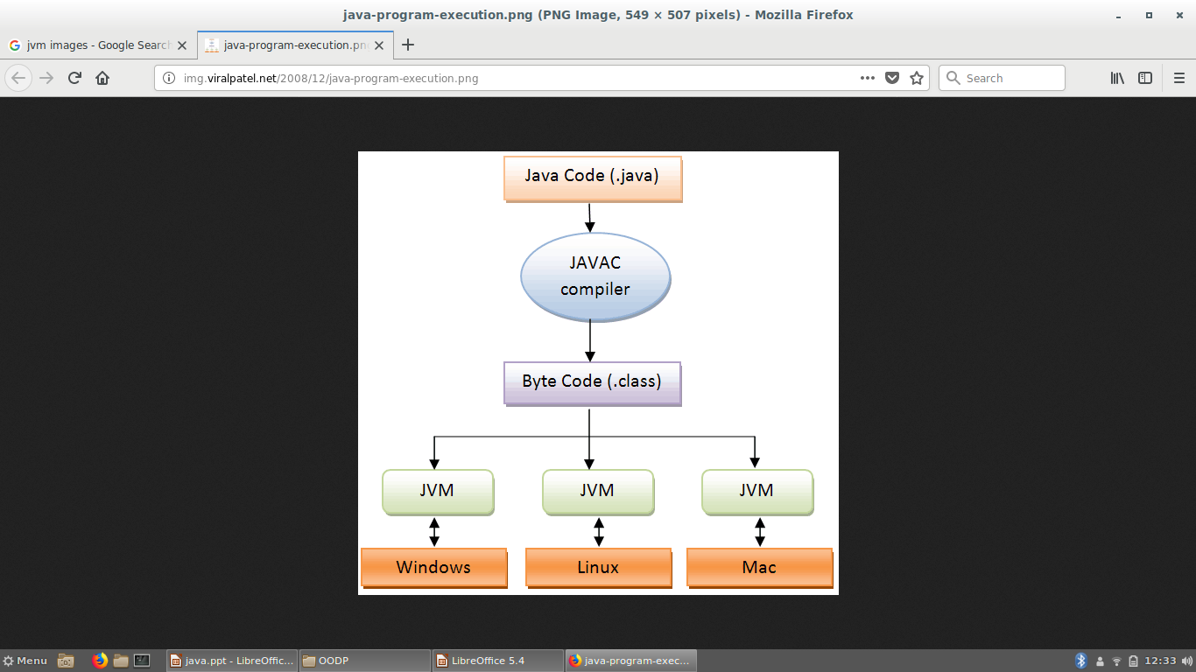

Slide 4
JVM Overview
Classloader
Read class file stream.
Verify the class file.
Resolve the class link.
Load into memory.
Interpreter
Execute Java bytecode.
Garbage Collector
Delete unused Java objects automatically.

Slide 5
The Java Keywords
Abstract, continue, for, new, switch, assert, default, goto, package, synchronized, boolean, do, if, private, this, break, double, implements, protected, throw, byte, else, import, public, throws, case, enum, instanceof, return, transient, catch, extends, int, short, try, char, final, interface, static, void, class, finally, long, strictfp, volatile, const, float, native, super, while

Slide 6
Your first Java application.
class Example {
// Your program begins with a call to main().
public static void main(String args[]) {
System.out.println("This is a simple Java program.");
}
}

Slide 7
Compile and Run the Program
javac Example.java
The javac compiler creates a file called Example.class that contains the bytecode version of the program
When Java source code is compiled, each individual class is put into its own output file named after the class and using the .class extension.
java Example

Slide 8
A Closer Look
Comments
single line comments //
Multi-line comments /*.. */
Javadoc /** ...*/
class Example {
public static void main(String args[ ]) {
All Java applications begin execution by calling
main( ).

Slide 9
Data Types
The Primitive Types
byte, short, int, long, char, float, double, and boolean
Integers
long : 64bits –9,223,372,036,854,775,808 to 9,223,372,036,854,775,807
int : 32bits –2,147,483,648 to 2,147,483,647
short : 16bits –32,768 to 32,767
byte : 8bits –128 to 127

Slide 10
Data Types
Floating-Point Types
double: 64bits 4.9e–324 to 1.8e+308
float: 32bits 1.4e–045 to 3.4e+038
Characters
char
Java uses Unicode to represent characters.
Unicode defines a fully international character set that can represent all of the characters found in all human languages.
Java char is a 16-bit type. The range of a char is 0 to 65,536.

Slide 11
Program that demonstrates char variables
class CharDemo {
public static void main(String args[]) {
char ch1, ch2;
ch1 = 88; // code for X
ch2 = 'Y';
System.out.print("ch1 and ch2: ");
System.out.println(ch1 + " " + ch2);
}
}

Slide 12
Booleans
class BoolTest {
public static void main(String args[]) {
boolean b;
b = false;
System.out.println("b is " + b);
b = true;
System.out.println("b is " + b);
if(b) System.out.println("This is executed.");
b = false;
System.out.println("10 > 9 is " + (10 > 9));
}
}

Slide 13
Variables
Declaring a Variable
type identifier [ = value ][, identifier [= value ] ...];
type is one of Java’s atomic types, or the name of a class or interface
The identifier is the name of the variable
int a, b, c;
int d = 3, e, f = 5;
byte z = 22;
double pi = 3.14159;
char x = 'x';

Slide 14
The Scope and Lifetime of Variables
A block defines a scope
determines what objects are visible to other parts of your program.
determines the lifetime of those objects
objects declared in the outer scope will be visible to code within the inner scope

Slide 15
Scope
class Scope {
public static void main(String args[]) {
int x; // known to all code within main
x = 10;
if(x == 10) { // start new scope
int y = 20; // known only to this block
// x and y both known here.
System.out.println("x and y: " + x + " " + y);
x = y * 2;
}
y = 100;
System.out.println("x is " + x);
}
}.

Slide 16
Lifetime
lifetime of a variable refers to how long the variable stays alive in memory.
class LifeTime {
public static void main(String args[]) {
int x;
for(x = 0; x < 3; x++) {
int y = -1; // y is initialized each time block is entered
System.out.println("y is: " + y); // this always prints -1
y = 100;
System.out.println("y is now: " + y);
}
}
}

Slide 17
Although blocks can be nested, you cannot declare a variable to have the same name as one in an outer scope. For example, the following program is illegal:
class ScopeErr {
public static void main(String args[]) {
int bar = 1;
{
int bar = 2;
// creates a new scope
// Compile-time error – bar already defined!
}
}}

Slide 18
Type Conversion and Casting
When one type of data is assigned to another type of variable, an automatic type conversion will take place if the following two conditions are met:
The two types are compatible.
The destination type is larger than the source type.
Integer and floating-point types, are compatible with each other
There are no automatic conversions from the numeric types to char or boolean. Also, char and boolean are not compatible with each other.

Slide 19
Casting Incompatible Types
To create a conversion between two incompatible types, you must use a cast.
A cast is simply an explicit type conversion. It has this general form:
(target-type) value
int a;
byte b;
b = (byte) a;

Slide 20
Casting Incompatible Types
If the size of the whole number component is too large to fit into the target integer type, then that value will be reduced modulo the target type’s range.
A different type of conversion will occur when a floating-point value is assigned to an
integer type: truncation.

Slide 21
Casting Incompatible Types
class Conversion {
public static void main(String args[]) {
byte b;
int i = 257;
double d = 323.142;
b = (byte) i;
System.out.println("i and b " + i + " " + b);
i = (int) d;
System.out.println("d and i " + d + " " + i);
b = (byte) d;
System.out.println("d and b " + d + " " + b);
}
}

Slide 22
Casting Incompatible Types
This program generates the following output:
Conversion of int to byte.
i and b 257 1
Conversion of double to int.
d and i 323.142 323
Conversion of double to byte.
d and b 323.142 67

Slide 23
Automatic Type Promotion in Expressions
byte a = 40;
byte b = 50;
byte c = 100;
int d = a * b / c;
byte b = 50;
b = b * 2;
The Type Promotion Rules
All byte, short, and char values are promoted to int. Then, if one operand is a long, the whole expression is promoted to long. If one operand is a float, the entire expression is promoted to float. If any of the operands are double, the result is double.

Slide 24
Arrays
The general form of a one-dimensional array declaration is
type array-var[ ];
To allocate memory
array-var = new type [size];
The elements in the array allocated by new will automatically be initialized to zero (for numeric types), false (for boolean), or null
Eg: int month_days[]; month_days = new int[12];
Or
int month_days[] = new int[12];

Slide 25
Arrays
class AutoArray {
public static void main(String args[]) {
int month_days[] = { 31, 28, 31, 30, 31, 30, 31, 31, 30, 31,
30, 31 };
System.out.println("April has " + month_days[3] + " days.");
}
}

Slide 26
Multidimensional Arrays
class TwoDArray {
public static void main(String args[]) {
int twoD[][]= new int[4][5];
int i, j, k = 0;
for(i=0; i<4; i++)
for(j=0; j<5; j++) {
twoD[i][j] = k;
k++;
}
for(i=0; i<4; i++) {
for(j=0; j<5; j++)
System.out.print(twoD[i][j] + " ");
System.out.println();
}
}
}

Slide 27
Alternative Array Declaration Syntax
Following two declarations are equivalent:
int al[] = new int[3]; or int[] a2 = new int[3];
The following declarations are also equivalent:
char twod1[][] = new char[3][4]; or char[][] twod2 = new char[3][4];
This alternative declaration form offers convenience when declaring several arrays at the same time.
For example,
int[] nums, nums2, nums3; // create three arrays
creates three array variables of type int. It is the same as writing
int nums[], nums2[], nums3[]; //

